Slide 1


ecs36b Spring 2020: Software Development & Object-Oriented Programming #03: Operator Overloading (1/2)
Abstraction
Encapsulation
Polymorphism
Inheritance
Dr. S. Felix Wu
sfwu@ucdavis.edu

Slide 2







a complex system

Slide 3
class Box;
class Person;
Object-
Oriented
Modeling
a complex system

Slide 4
// Box.h
class Box {
private:
…
public:
mb_func(…);
};
class Box;
class Person;
digital twin
object Box
Object-
Oriented
Modeling
a complex system

Slide 5
// Box.h
class Box {
private:
…
public:
mb_func(…);
};
// Box.cpp
#include “Box.h”
Box::mb_func(…)
{
// implementation
…
}
class Box;
class Person;
digital twin
object Box
Object-
Oriented
Modeling
// main.cpp
#include “Box.h”
int
main (…)
{
Box firstBox {…};
…
}
a complex system

Slide 6
// Box.h
class Box {
private:
…
public:
mb_func(…);
};
// Box.cpp
#include “Box.h”
Box::mb_func(…)
{
// implementation
…
}
class Box;
class Person;
g++ -std=c++17 -c Box.cpp
digital twin
object Box
Object-
Oriented
Modeling
compiler
g++ -std=c++17 -c main.cpp
// main.cpp
#include “Box.h”
int
main (…)
{
Box firstBox {…};
…
}
a complex system

Slide 7
// Box.h
class Box {
private:
…
public:
mb_func(…);
};
// Box.cpp
#include “Box.h”
Box::mb_func(…)
{
// implementation
…
}
class Box;
class Person;
g++ -std=c++17 -c Box.cpp
digital twin
object Box
Box.o
Object-
Oriented
Modeling
compiler
main.o
g++ -std=c++17 -c main.cpp
// main.cpp
#include “Box.h”
int
main (…)
{
Box firstBox {…};
…
}
a complex system

Slide 8
// Box.h
class Box {
private:
…
public:
mb_func(…);
};
// Box.cpp
#include “Box.h”
Box::mb_func(…)
{
// implementation
…
}
class Box;
class Person;
g++ -std=c++17 -c Box.cpp
digital twin
object Box
Box.o
Object-
Oriented
Modeling
compiler
linker
executable
main.o
g++ -std=c++17 -c main.cpp
// main.cpp
#include “Box.h”
int
main (…)
{
Box firstBox {…};
…
}
a complex system

Slide 9
// Box.h
class Box {
private:
…
public:
mb_func(…);
};
// Box.cpp
#include “Box.h”
Box::mb_func(…)
{
// implementation
…
}
class Box;
class Person;
g++ -std=c++17 -c Box.cpp
digital twin
object Box
Box.o
Object-
Oriented
Modeling
compiler
linker
executable
main.o
g++ -std=c++17 -c main.cpp
// main.cpp
#include “Box.h”
int
main (…)
{
Box firstBox {…};
…
}
a complex system

Slide 10
Preprocessing
Compiling
Linking

Slide 11
df, sftp, ssh, rsync

Slide 12
Operator Overloading Chapter 12, Horton
What is Operator Overloading?
Extending the meaning of operators, such as “>”, to handle C++ objects
Why do we need to overload the operators?
Constructors and Destructors

Slide 13
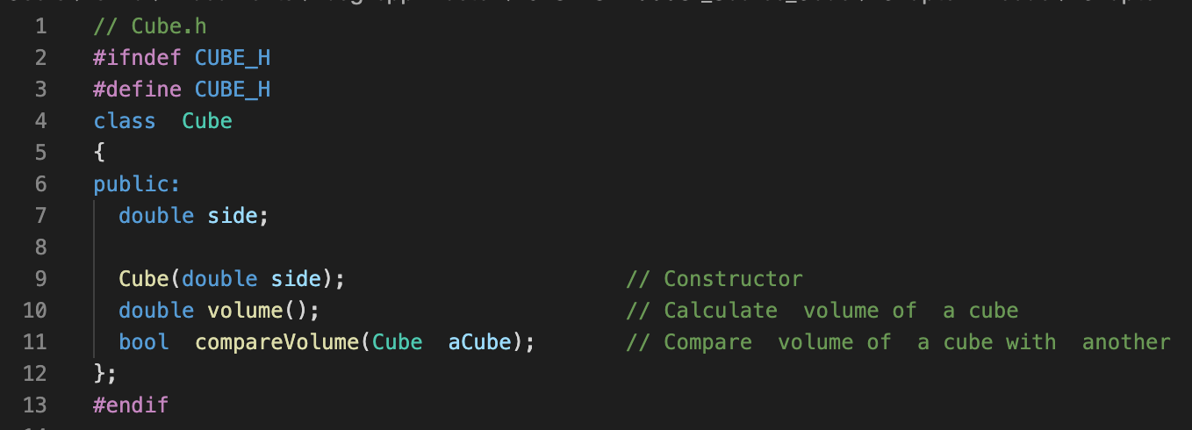
// from Ex11_02
if (box1.compareVolume(box2))
{
std::cout << "box1 is larger than box2." << std::endl;
}

Slide 14
// from Ex11_02
if (box1.compareVolume(box2))
{
std::cout << "box1 is larger than box2." << std::endl;
}
// from Ex11_02 with Operator Overloading, Ex12_01
if (box1 > box2)
{
std::cout << "box1 is larger than box2." << std::endl;
}

Slide 15
// from Ex11_02
if (box1.compareVolume(box2))
{
std::cout << "box1 is larger than box2." << std::endl;
}
Take away point: Operator Overloading is for better code readability
less for convenience
// from Ex11_02 with Operator Overloading, Ex12_01
if (box1 > box2)
{
std::cout << "box1 is larger than box2." << std::endl;
}

Slide 16
// from Ex12_01
class Box {…
bool operator>(const Box& aBox) const // Less-than op
{
return volume() > aBox.volume();
}
// from Ex11_02 with Operator Overloading, Ex12_01
if (box1 > box2)
{
std::cout << "box1 is larger than box2." << std::endl;
}

Slide 17
// from Ex12_01
Class Box {…
bool operator>(const Box& aBox) const // greater-than op
{
return volume() > aBox.volume();
}
The const member functions are the functions which are declared as constant in the program. The object called by these functions cannot be modified. It is recommended to use const keyword so that accidental changes to object are avoided.
// from Ex11_02 with Operator Overloading, Ex12_01
if (box1 > box2)
{
std::cout << "box1 is larger than box2." << std::endl;
}

Slide 18
Box2 ➔
aBox
Box2 ➔
aBox xyz
w/o &

Slide 19
Overloadable Operators
>, <, ==, !=, >=, <=, &&, ||, …
+, -, *, /, =
>>, +=, [ ]
( )
Except
::, ?:, ., .*, sizeof

Slide 20
Warning!!
You should learn very well about operator overloading such that you can 100% correctly understand somebody else’s code.
But, you need to make sensible decisions when you consider to overload operators for classes/objects, depending on the situation.
Operator Overloading is for better code readability

Slide 21
// from Ex11_02 with Operator Overloading, Ex12_01
if (box1 > box2)
{
std::cout << "box1 is larger than box2." << std::endl;
}
You know the meaning of > because there is only one public member function “Volume” for class Box.

Slide 22
// from Ex11_02 with Operator Overloading, Ex12_01
if (box1 > box2)
{
std::cout << "box1 is larger than box2." << std::endl;
}
You know the meaning of > because there is only one public member function “Volume” for class Box.
// complex objects
if (person1 > person2)
{
std::cout << ”person1 is better than person2." << std::endl;
}

Slide 23
// complexit object, Person.h
class Person {…
bool operator>(const Person& aPerson) const;
…
How do we know the precise/correct meaning about the overloaded operators?
// complex objects
if (person1 > person2)
{
std::cout << ”person1 is better than person2." << std::endl;
}
Volume, height, age, blood pressure, number of hairs, IQ, or EQ???

Slide 24
Person.cpp
bool Person::operator>(const Person& aPerson) const
{
return blood_pressure() > aPerson.blood_pressure();
}
Unless you have already worked on the same team, you will need to read original source code of Person.cpp.

Slide 25
// Box.h
class Box {
private:
…
public:
mb_func(…);
};
// Box.cpp
#include “Box.h”
Box::mb_func(…)
{
// implementation
…
}
class Box;
class Person;
g++ -std=c++17 -c Box.cpp
digital twin
object Box
Box.o
Object-
Oriented
Modeling
compiler
linker
executable
main.o
g++ -std=c++17 -c main.cpp
// main.cpp
#include “Box.h”
int
main (…)
{
Box firstBox {…};
…
}
a complex system

Slide 26
Person.cpp
bool Person::operator>(const Person& aPerson) const
{
return blood_pressure() > aPerson.blood_pressure();
}
Unless you have already worked on the same team, you will need to read original source code of Person.cpp.
Congratulations!! We just broke encapsulation!
And, for the Object-Oriented paradigm, depending on how you do it, you might be conflicting with another principle!

Slide 27
// Person.h
class Person {
private:
…
public:
mb_func(…);
};
// Person.cpp
#include “Person.h”
Person::mb_func(…)
{
// implementation
…
}
Class
Transaction;
class Person;
g++ -std=c++17 -c Person.cpp
digital twin
object Person
Person.o
Object-
Oriented
Modeling
compiler
linker
executable
main.o
g++ -std=c++17 -c main.cpp
// main.cpp
#include “Person.h”
int
main (…)
{
Person first {…};
…
}
a complex system

Slide 28
Person.cpp
bool Person::operator==(const Person& aPerson) const
{
}
Unless you have already worked on the same team, you will need to read original source code of Person.cpp.

Slide 29
/Library/Developer/CommandLineTools/usr/include/c++/v1/utility
namespace rel_ops
{
template<class _Tp>
inline _LIBCPP_INLINE_VISIBILITY
bool
operator!=(const _Tp& __x, const _Tp& __y)
{
return !(__x == __y);
}
template<class _Tp>
inline _LIBCPP_INLINE_VISIBILITY
bool
operator> (const _Tp& __x, const _Tp& __y)
{
return __y < __x;
}
template<class _Tp>
inline _LIBCPP_INLINE_VISIBILITY
bool
operator<=(const _Tp& __x, const _Tp& __y)
{
return !(__y < __x);
}
==, !=, < , >, <=, >=
template<class _Tp>
inline _LIBCPP_INLINE_VISIBILITY
bool
operator>=(const _Tp& __x, const _Tp& __y)
{
return !(__x < __y);
}
} // rel_ops

Slide 30
Operator Overloading Chapter 12, Horton
What is Operator Overloading?
Extending the meaning of operators, such as “>”, to handle C++ objects
Why do we need to overload the operators?
Be careful, and use it appropriately.

Slide 31
// from Ex11_02 with Operator Overloading, Ex12_01
if (box1 > box2)
{
std::cout << "box1 is larger than box2." << std::endl;
}
// from Ex12_01
class Box {…
bool operator>(const Box& aBox) const // Less-than op
{
return this->volume() > aBox.volume();
}

Slide 32
// from Ex11_02 with Operator Overloading, Ex12_01
if (box1 > box2)
{
std::cout << "box1 is larger than box2." << std::endl;
}
// from Ex12_01
class Box {…
bool operator>(const Box& aBox) const // Less-than op
{
return this->volume() > aBox.volume();
}

Slide 33
Person.cpp
bool Person::operator>(const Person& aPerson) const
{
return blood_pressure() > aPerson.blood_pressure();
}
Unless you have already worked on the same team, you will need to read original source code of Person.cpp.
Congratulations!! We just broke encapsulation!
And, for the Object-Oriented paradigm, depending on how you do it, you might be conflicting with another principle!

Slide 34
// from Ex11_02 with Operator Overloading, Ex12_01
if (box1 > box2)
{
std::cout << "box1 is larger than box2." << std::endl;
}
// global operator function
inline bool operator>(const Box& box1, const Box& box2)
{
return box1.volume() > box2.volume();
}
Which option is better?
// overloaded class operator
class Box {…
bool operator>(const Box& aBox) const // Less-than op
{
return this->volume() > aBox.volume();
}

Slide 35
// from Ex11_02 with Operator Overloading, Ex12_01
if (box1 > 25.0)
{
std::cout << "box1 is larger than 25.0." << std::endl;
}
// overloaded class operator
class Box {…
bool operator>(double aValue) const
{
// try yourself!!
}

Slide 36
Overloading Relational Operators
==, !=, > , <, <=, >=
#include <utility>
using namespace std::rel_ops;

Slide 37
Comparing these two pieces of programs

Slide 38
#include <utility>
using namespace std::rel_ops;
class Person
{
private:
static unsigned int person_count;
std::string vsID;
std::string name;
std::string hometown;
GPS_DD home;
public:
Person();
Person(std::string, std::string);
void setHome(std::string);
void setHome(GPS_DD);
bool operator==(Person& aPerson);
bool operator<(Person& aPerson);
std::string getVsID();
std::string getName();
};
class Person
{
private:
static unsigned int person_count;
std::string vsID;
std::string name;
std::string hometown;
GPS_DD home;
public:
Person();
Person(std::string, std::string);
void setHome(std::string);
void setHome(GPS_DD);
bool operator==(Person& aPerson);
bool operator>(Person& aPerson);
std::string getVsID();
std::string getName();
};

Slide 39
Person aPerson {…};
Person bPerson {…};
…
if (aPerson == bPerson)
if (aPerson != bPerson)
if (aPerson > bPerson)
if (aPerson < bPerson)
if (aPerson >= bPerson)
if (aPerson <= bPerson)
Which piece of class definition codes will pass the compiler?

Slide 40
Compiler plays smart…
== ➔ != (!(==))
< ➔ >= (!(<))
<, ==, ! together ➔ >, !=, <=, >=
All the programmer needs to do is to only overload < and == .

Slide 41
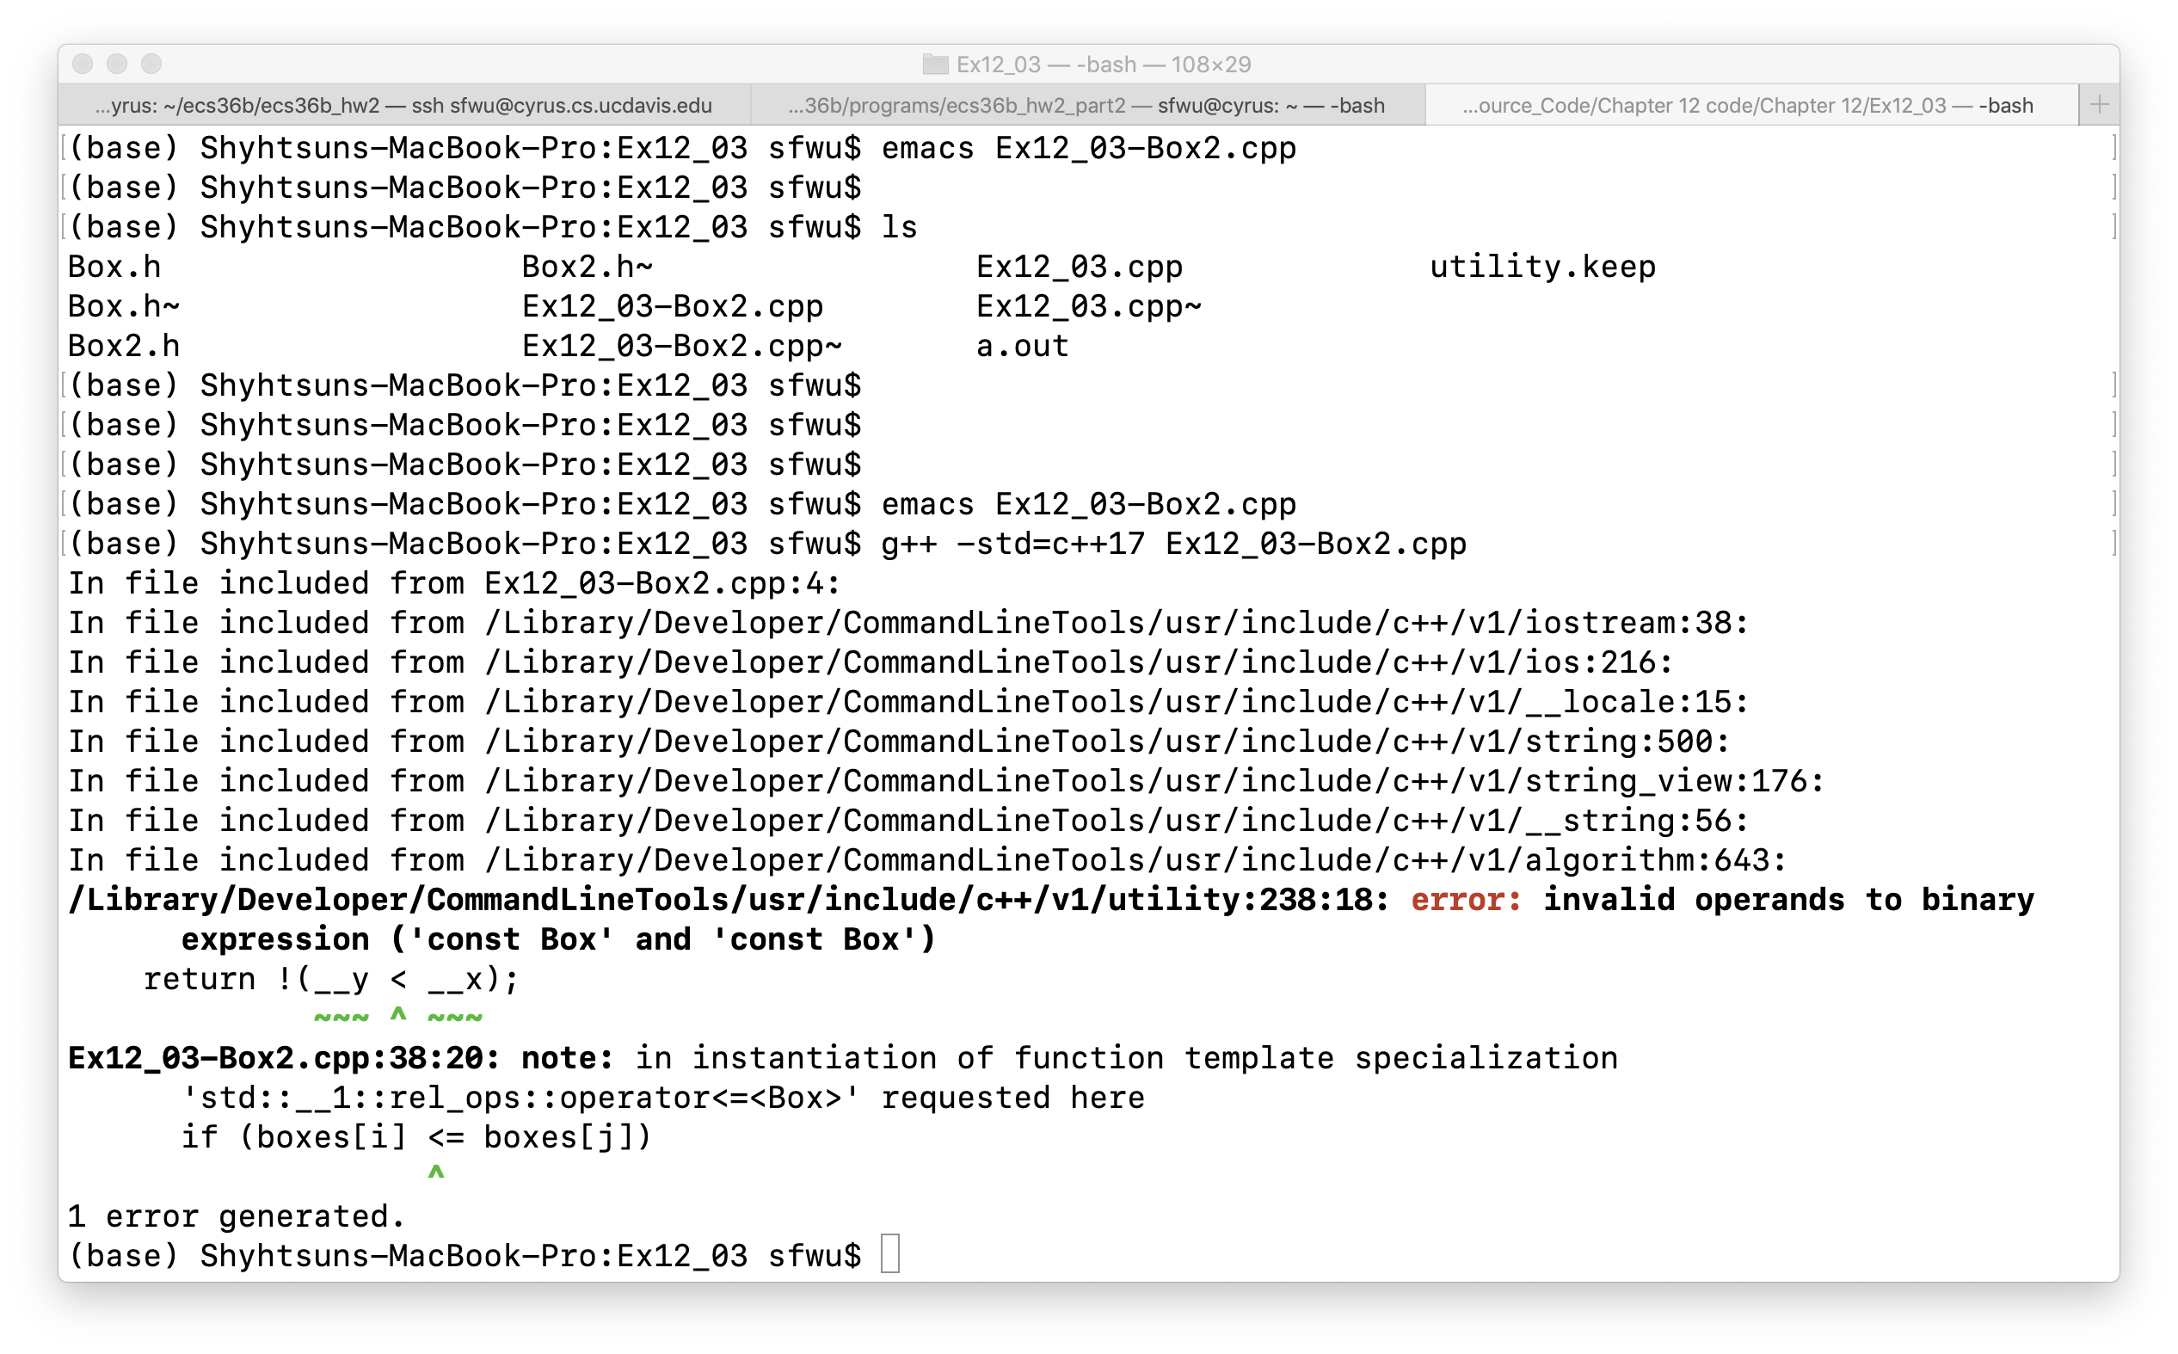
#include <utility>
Using namespace std::rel_ops;
/Library/Developer/CommandLineTools/usr/include/c++/v1/utility

Slide 42
/Library/Developer/CommandLineTools/usr/include/c++/v1/utility
namespace rel_ops
{
template<class _Tp>
inline _LIBCPP_INLINE_VISIBILITY
bool
operator!=(const _Tp& __x, const _Tp& __y)
{
return !(__x == __y);
}
template<class _Tp>
inline _LIBCPP_INLINE_VISIBILITY
bool
operator> (const _Tp& __x, const _Tp& __y)
{
return __y < __x;
}
template<class _Tp>
inline _LIBCPP_INLINE_VISIBILITY
bool
operator<=(const _Tp& __x, const _Tp& __y)
{
return !(__y < __x);
}
==, !=, < , >, <=, >=
template<class _Tp>
inline _LIBCPP_INLINE_VISIBILITY
bool
operator>=(const _Tp& __x, const _Tp& __y)
{
return !(__x < __y);
}
} // rel_ops

Slide 43
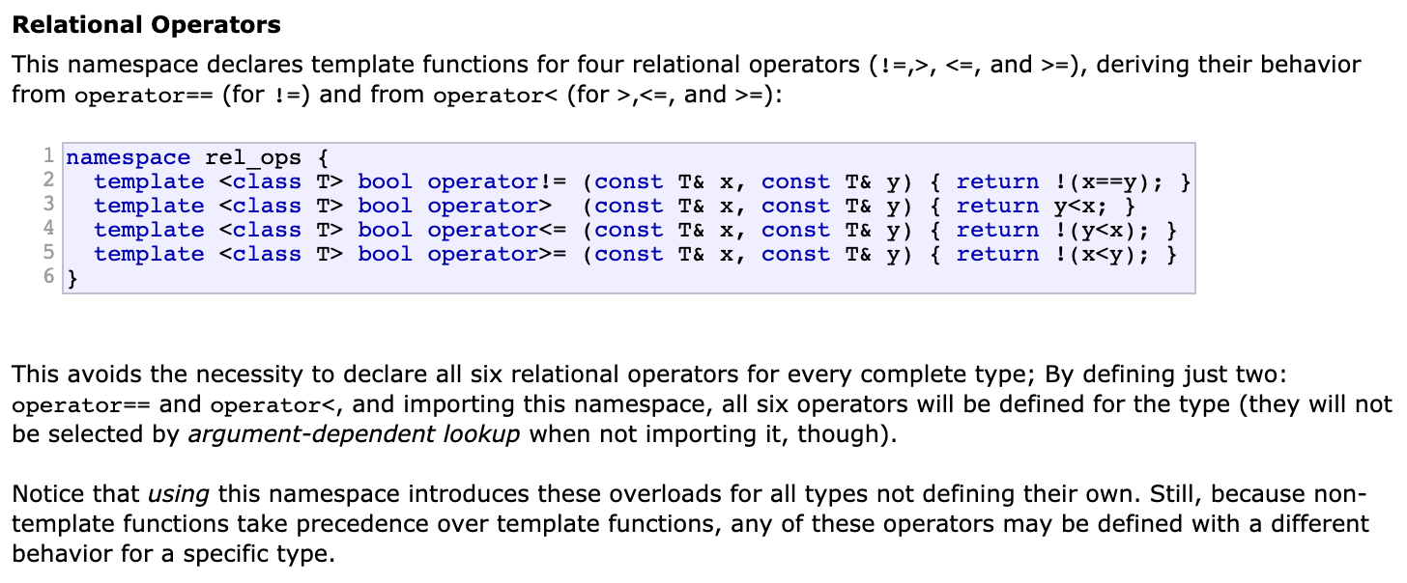
<, ==, ! together ➔ >, !=, <=, >=
All the programmer needs to do is to only overload < and ==
Check the <utility> file as well
And, we will talk about template later.

Slide 44
Default Constructors and Assignments (also Destructors, Chapter 12, pp 374-380)
class Data
{
public:
int value;
};
class Data
{
public:
int value;
// defaults (implicitly declared)
Data()
Data(const Data& aData)
Data(Data&& aData);
~Data();
Data& operator=(const Data& aData);
Data& operator=(const Data&& aData);
};
Implicitly-Declared
Constructors
Default Constructor
Copy Constructor
Move Constructor
Default Destructor
Copy Assignment
Move Assignment
Data *data_ptr = new Data(); // malloc, constr
delete data_ptr; // destruct, free

Slide 45
Constructors
Default
Do nothing
Copy Constructor
Allocate memory space for the constructor function argument, and copy the value into that space
Move Constructor
Use the memory space of ( or being pointed by) the constructor function argument without copying
User-defined
Implicitly declared

Slide 46
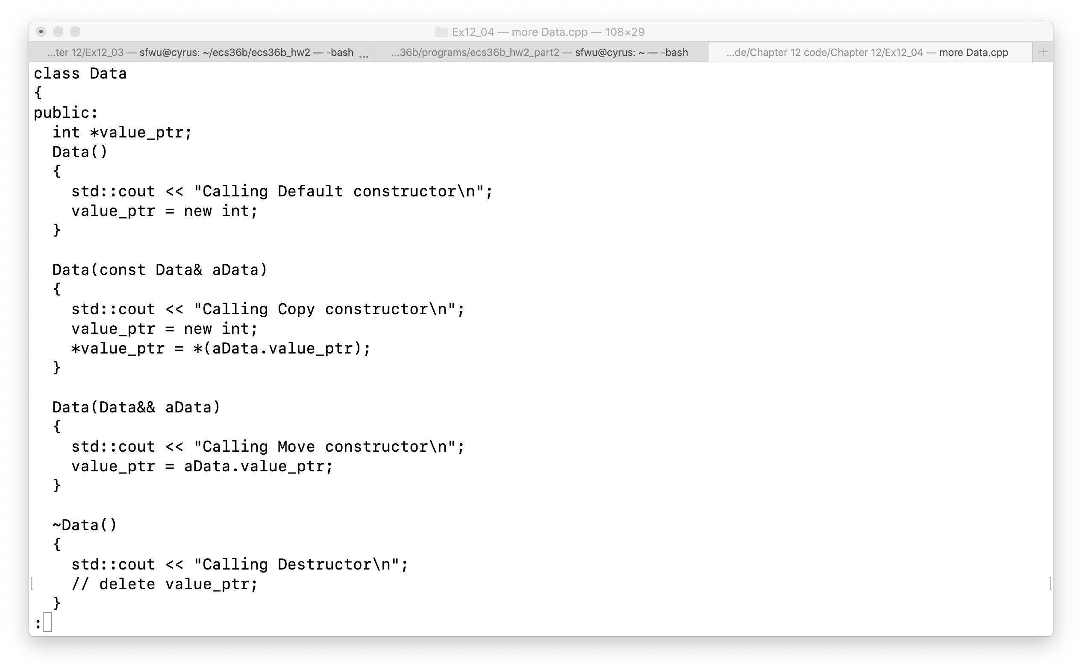
How to define and call?

Slide 47
New and delete
pointer_X = new <class X>(…);
Pointer_X = (class_X *) malloc(sizeof(<class X>);

Slide 48
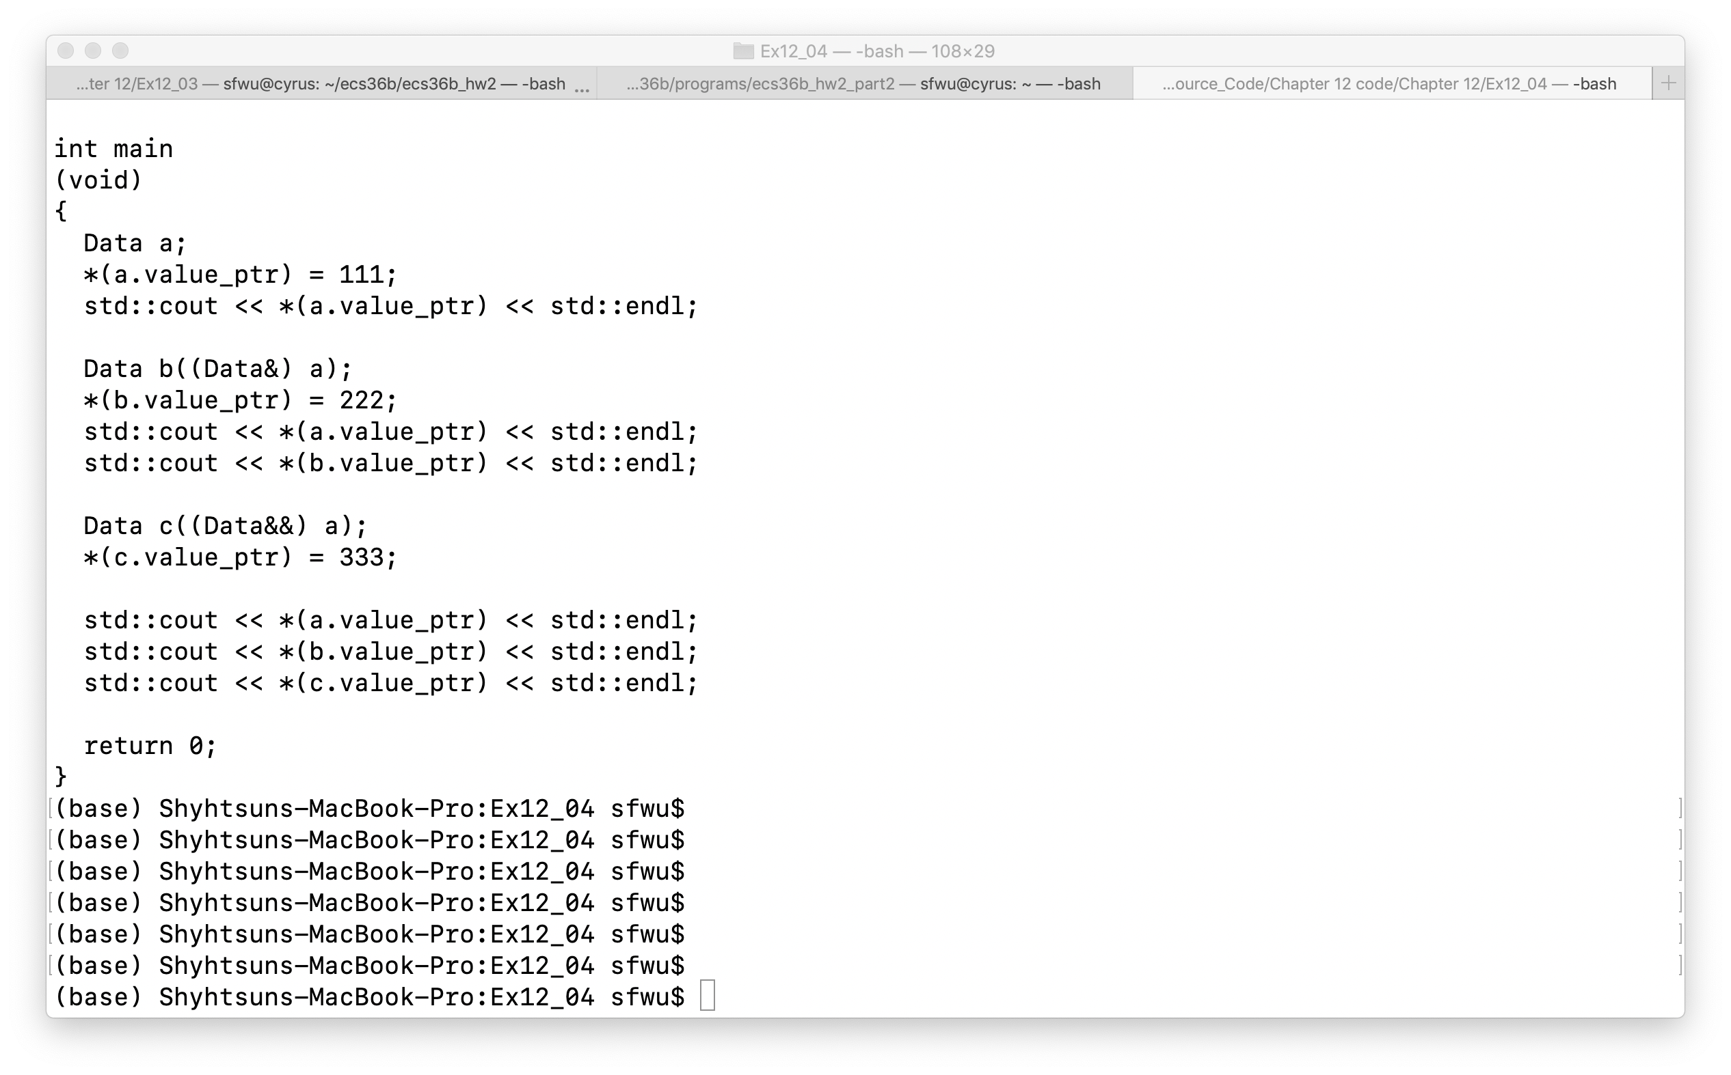
How to define and call?

Slide 49
How to define and call?

Slide 50
How to define and call?

Slide 51
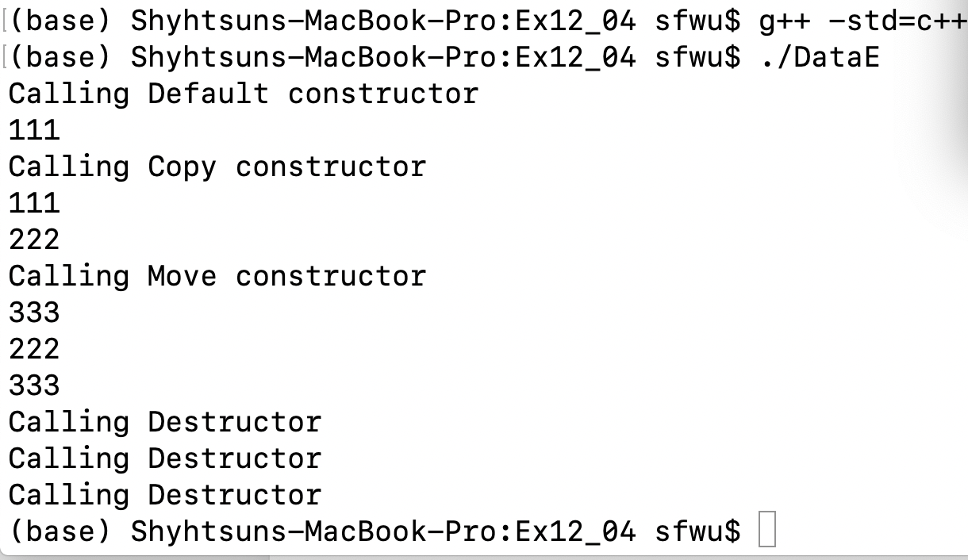
How to define and call?

Slide 52
How to define and call?

Slide 53
How to define and call?
Memory Leak
or
Memory Fault

Slide 54
Constructors
Default
Do nothing
Copy Constructor
Allocate memory space for the constructor function argument, and copy the value into that space
Move Constructor
Use the memory space of ( or being pointed by) the constructor function argument without copying
User-defined
Implicitly declared

Slide 55
Implicitly-Declared Constructors
Default
Do nothing
Copy Constructor
Allocate memory space for the constructor function argument, and copy the value into that space
Move Constructor
Use the memory space of ( or being pointed by) the constructor function argument without copying

Slide 56
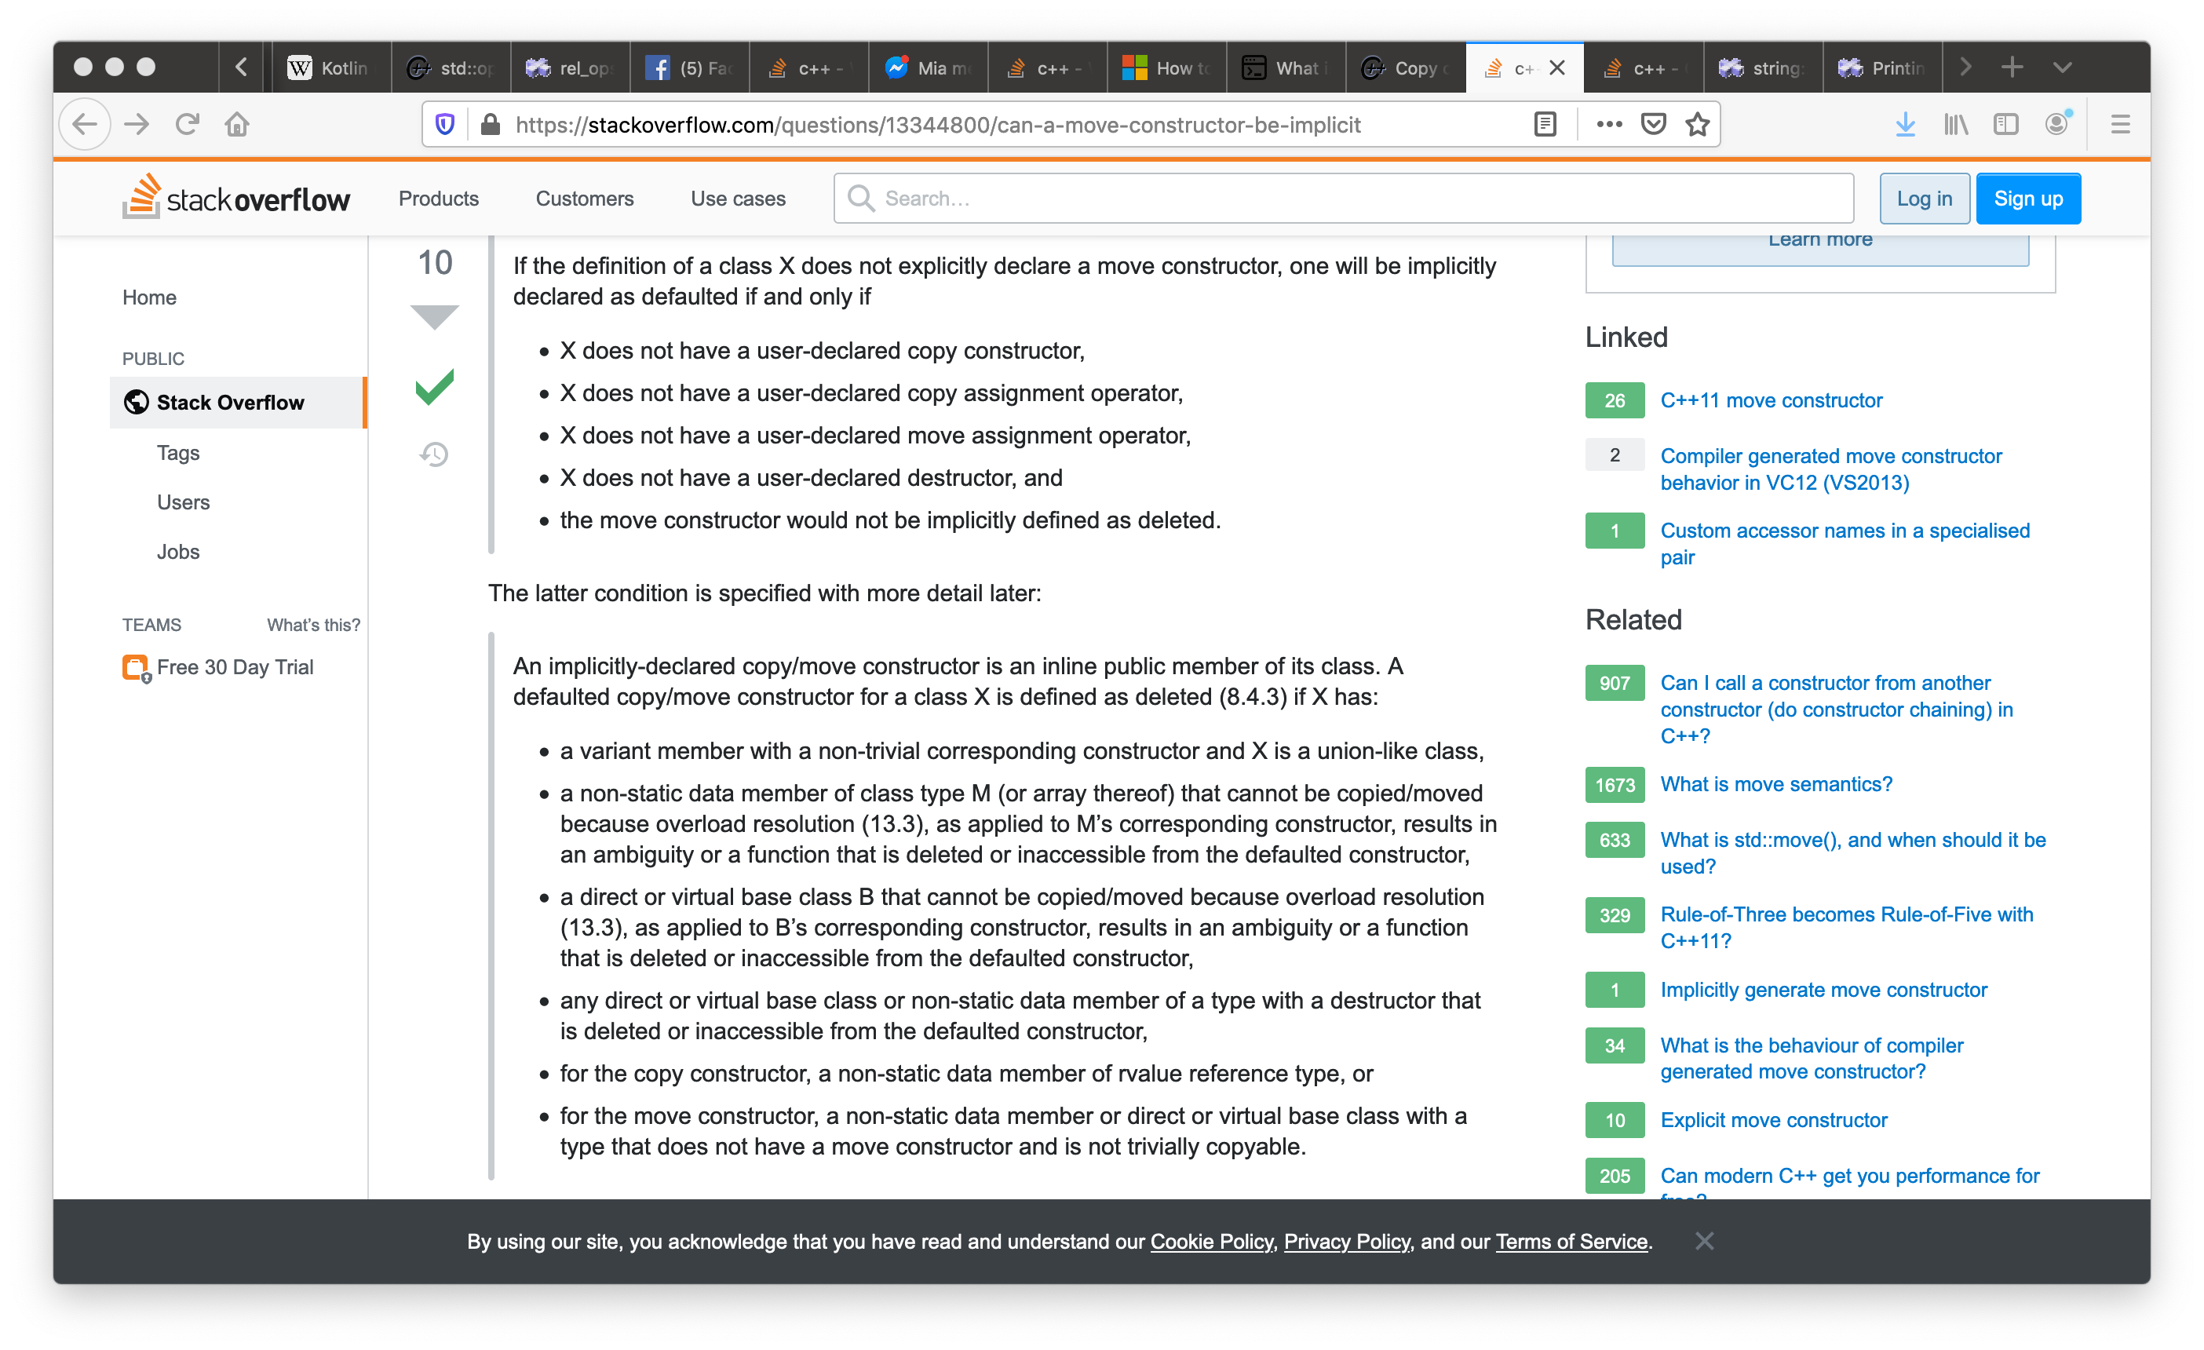

Slide 57
Constructors

Slide 58
Implicitly-declared Constructors

Slide 59
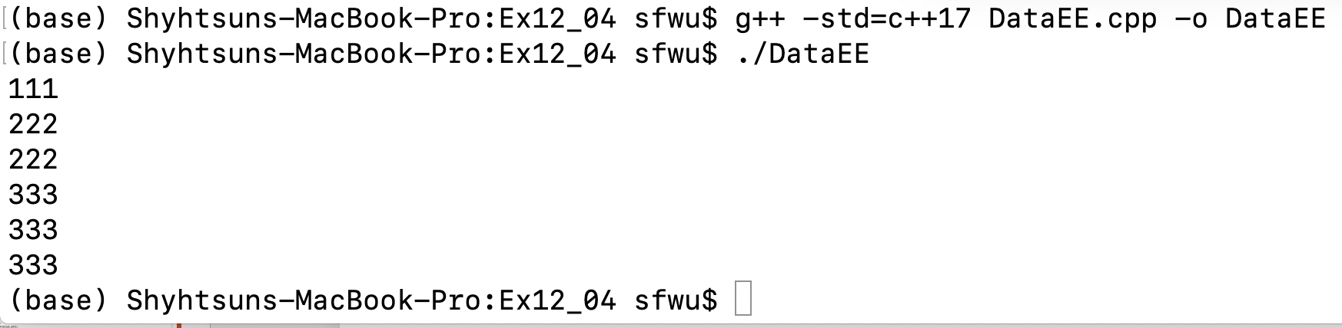
Implicitly-declared Constructors

Slide 60
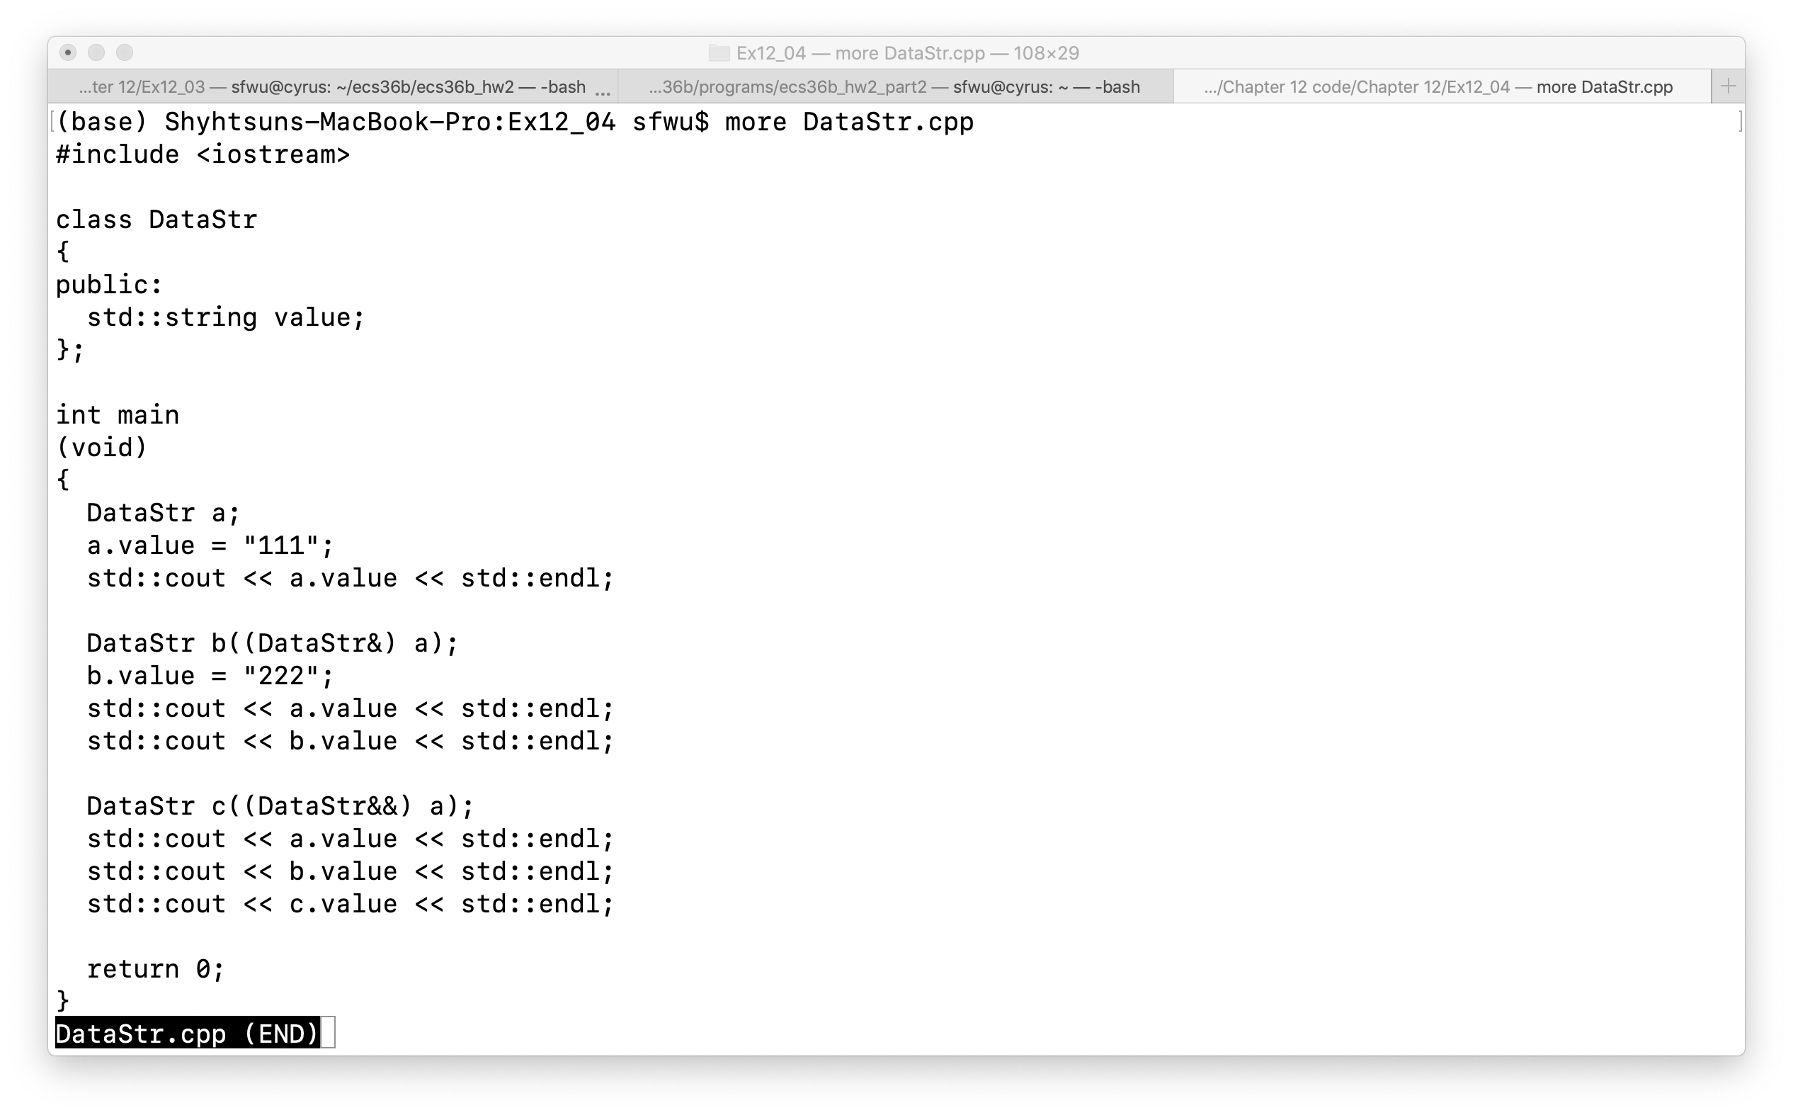

Slide 61
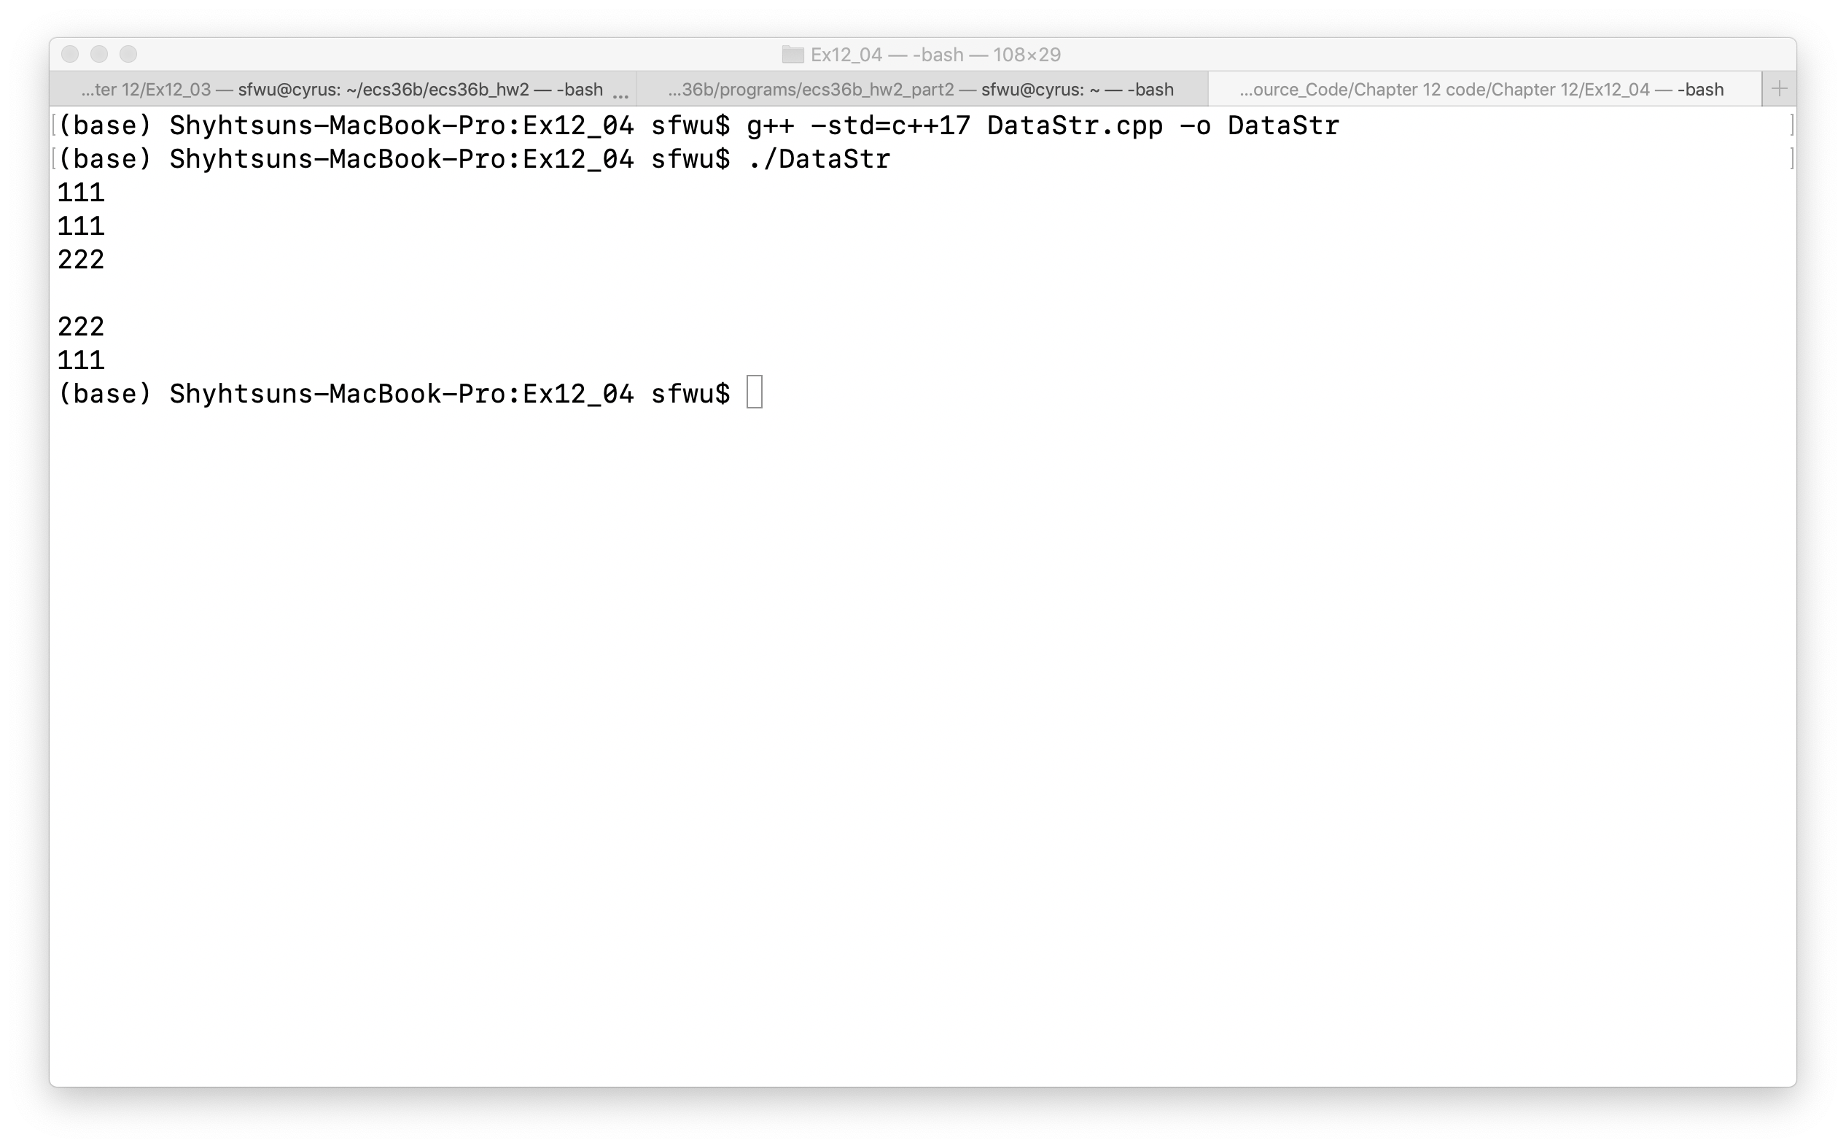

Slide 62
Default Constructors and Assignments (also Destructors, Chapter 12, pp 374-380)
class Data
{
public:
int value;
};
class Data
{
public:
int value;
// defaults (implicitly declared)
Data();
Data(const Data& aData);
Data(Data&& aData);
~Data();
Data& operator=(const Data& aData);
Data& operator=(const Data&& aData);
};
Implicitly-Declared
Constructors
Default Constructor
Copy Constructor
Move Constructor
Default Destructor
Copy Assignment
Move Assignment
Careful about using implicitly-declared Constructors or Assignments
Memory leak issue related to Destructors

Slide 63
Other topics in Chapter 12
Overloading Arithmetic operators
Overloading the Subscript operator
Overloading Type conversions
Overloading Increment and Decrement
Function Objects

Slide 64
Two topics
Overloading Relational Operators
User-defined versus Implicitly-Declared Constructors and Assignments

Slide 65
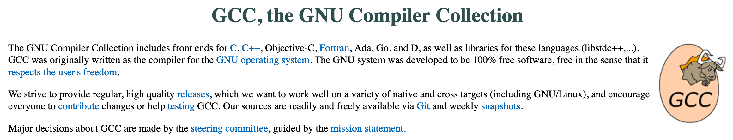
Two topics
Overloading Relational Operators
User-defined versus Implicitly-Declared Constructors and Assignments
/Library/Developer/CommandLineTools/usr/include/c++/v1/utility

Slide 66
Chapter 13, Inheritance Chapter 14, Polymorphism

